Slide 1

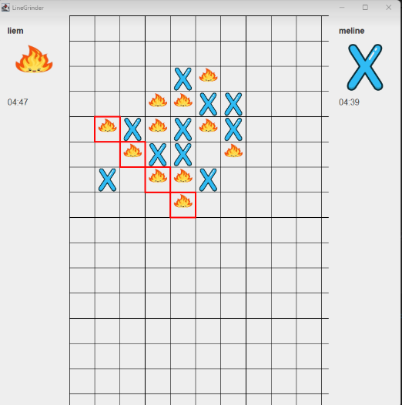

International University - Vietnam National University, HCM City
LineGrinder

Slide 2
International University - Vietnam National University, HCM City
MEMBERS
Phạm Thái Quốc - ITITWE21118
Nguyễn Trầm Gia Hưng - ITITIU23007
Bùi Thế Tùng - ITITIU22243
Phạm Nguyễn Công Danh - ITDSIU23035
Võ Nguyễn Thanh Liêm - ITITIU21069

Slide 3

TABLE OF CONTENTS
Introduction
01
Game Rules
02
Diagrams
03
Git Explanation
04
Lecture Applications
05
Limitation
06
Future Work
07
References
08

Slide 4



Introduction
Apply object-oriented programming (OOP) principles.
Enhance GUI development skills using Swing.
Experience real-world software development processes.

Slide 5
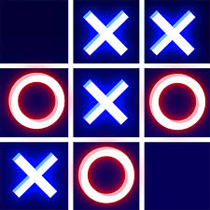

What is LineGrinder?
A strategy-based Connect5 game where players aim to align five consecutive stones on a grid.
Our Objective :
Develop LineGrinder – a modernized strategy game based on Gomoku, featuring new functionalities and an intuitive interface.
LineGrinder combines creativity and technology, aiming to meet entertainment needs with a unique and engaging strategy game.

Slide 6


Slide 7
Game Rules
Objective:
Aligning five consecutive pieces (horizontally, vertically, or diagonally) to win the game.
Gameplay
Winning Conditions
Timer Option (Optional)
Two players take turns placing their pieces on the grid.
The board size is customizable (e.g., 10x10, 15x15).
Players must strategize to block opponents while creating their winning line.
A player wins immediately after forming a line of five consecutive pieces.
No additional moves are allowed once a winner is declared.
Players have limited time to make their move, adding intensity and strategic pressure.

Slide 8


Slide 9

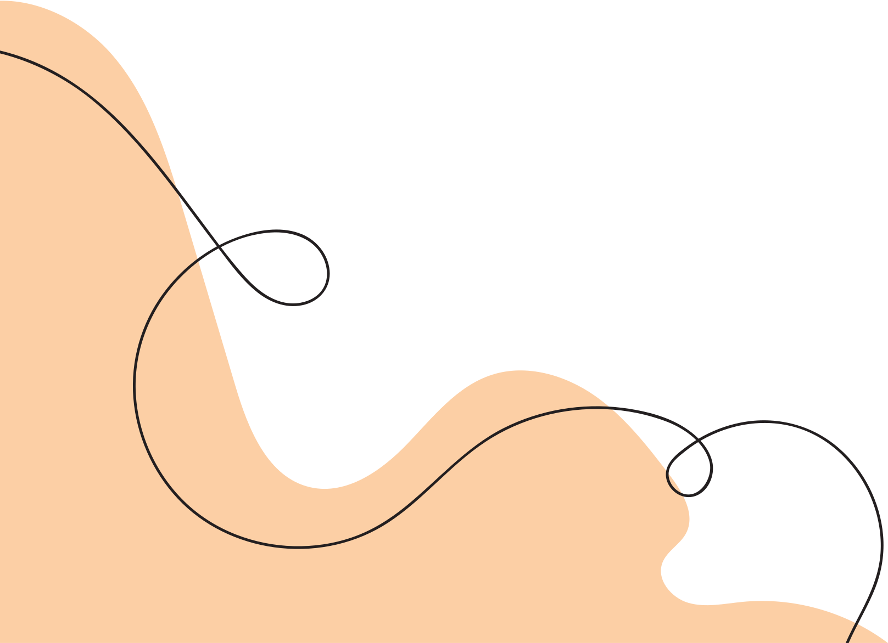
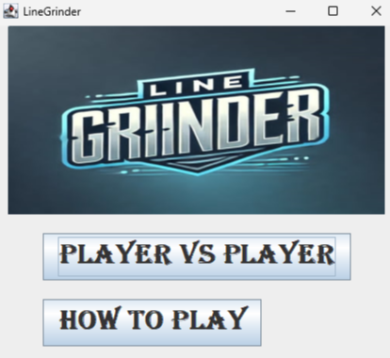


Slide 10
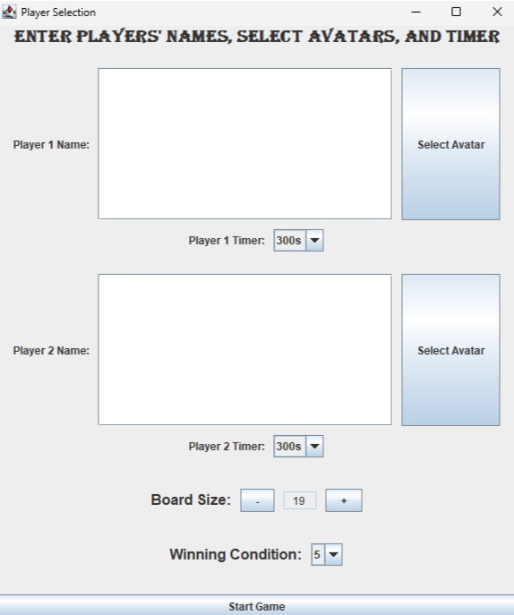
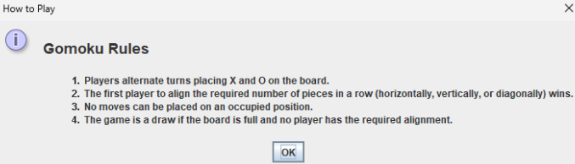
PLAYER VS PLAYER
HOW TO PLAY

Slide 11
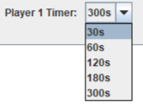
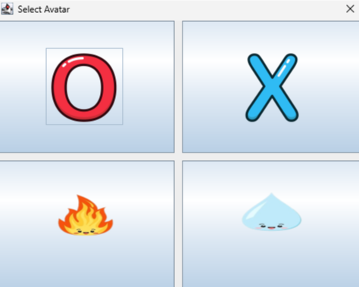
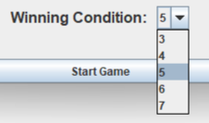
Select timer
Select Avatar
Select condition

Slide 12
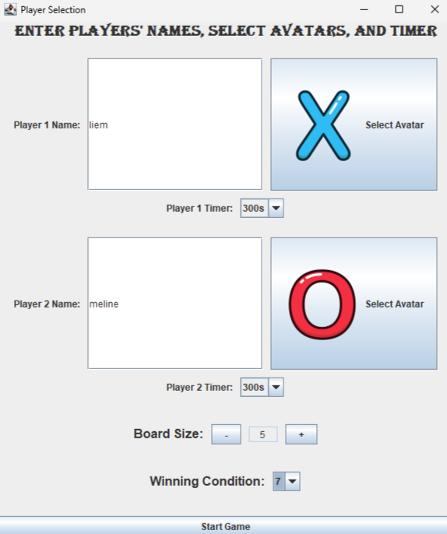
COMPLETED SELECTION

Slide 13
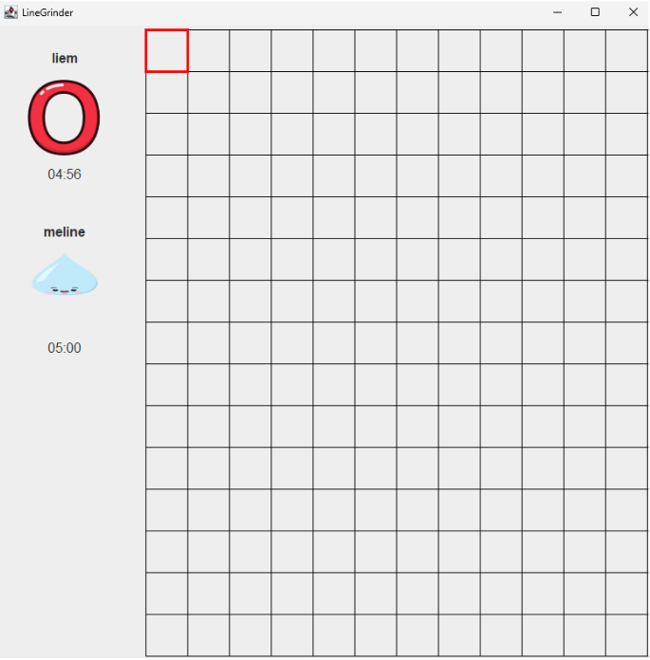
INTO THE GAME

Slide 14


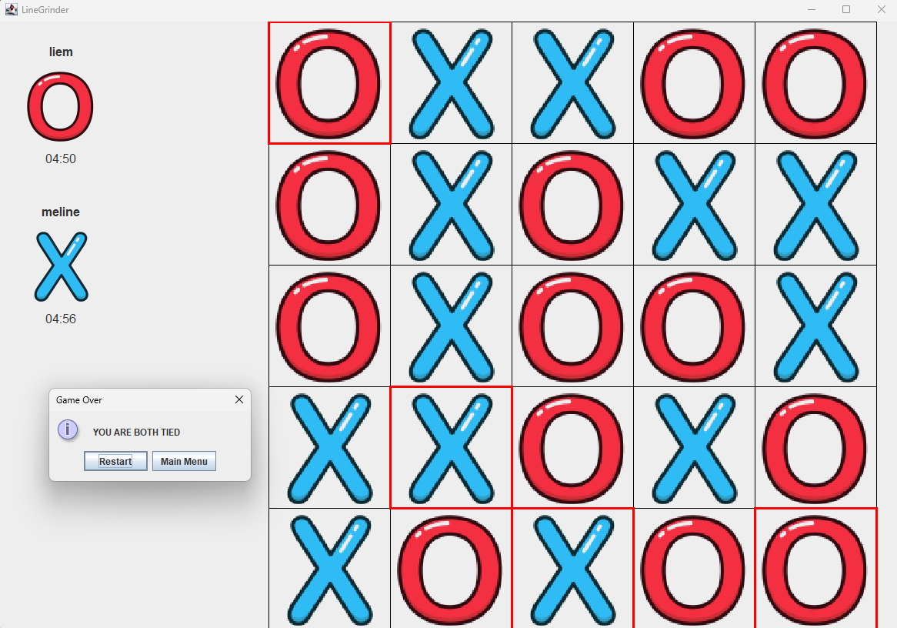
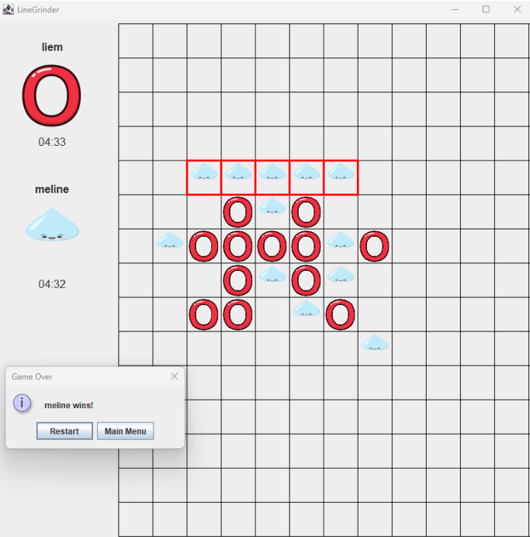
TIE GAME
Player’s win

Slide 15

01
UML Diagram
Diagrams
02
Class Diagram

Slide 16
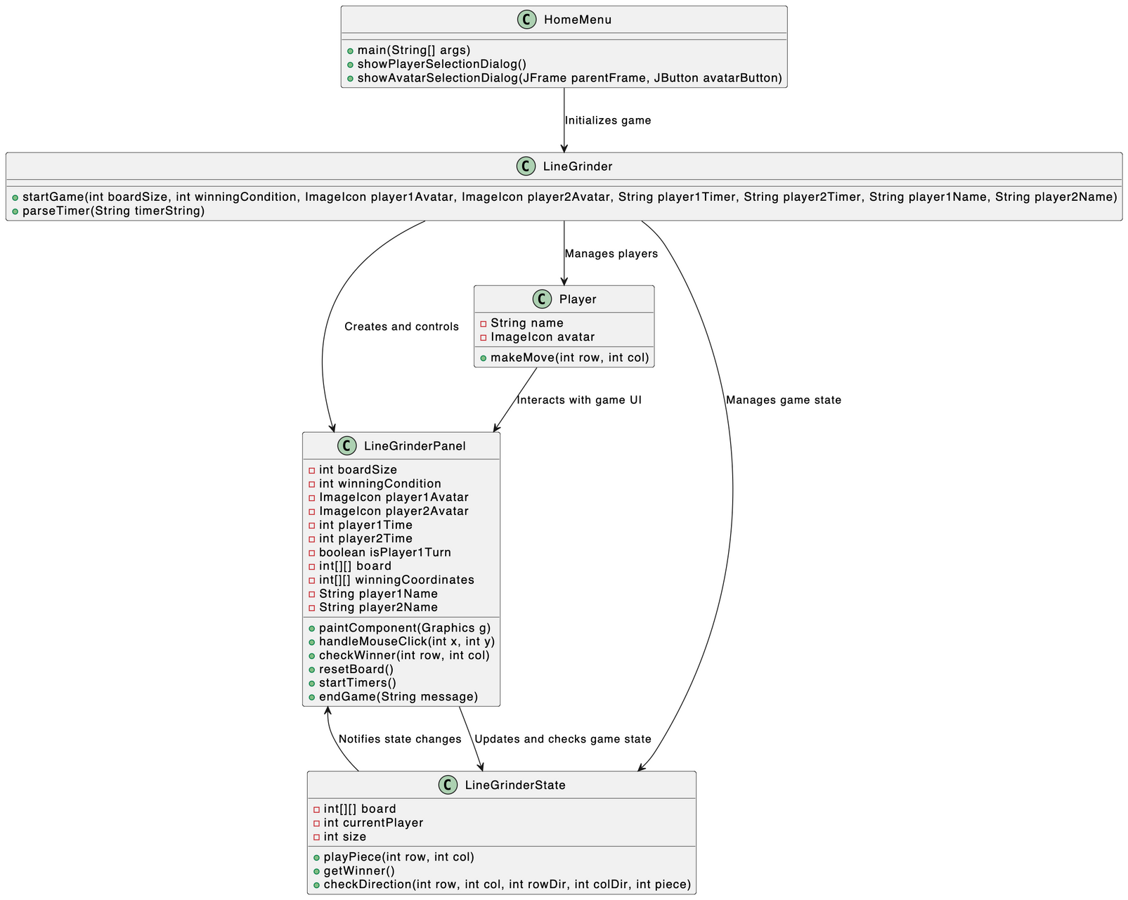
UML Diagram

Slide 17
Class Diagram

Slide 18
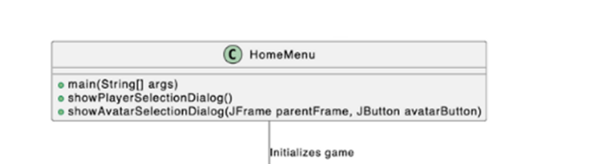
HomeMenu - Where it all begins
-main(): Starts the whole game.
-showPlayerSelectionDialog(): For players to choose their avatars and name.
-showAvatarSelectionDiaglog(): Pop up showing all the avatars that are available.

Slide 19
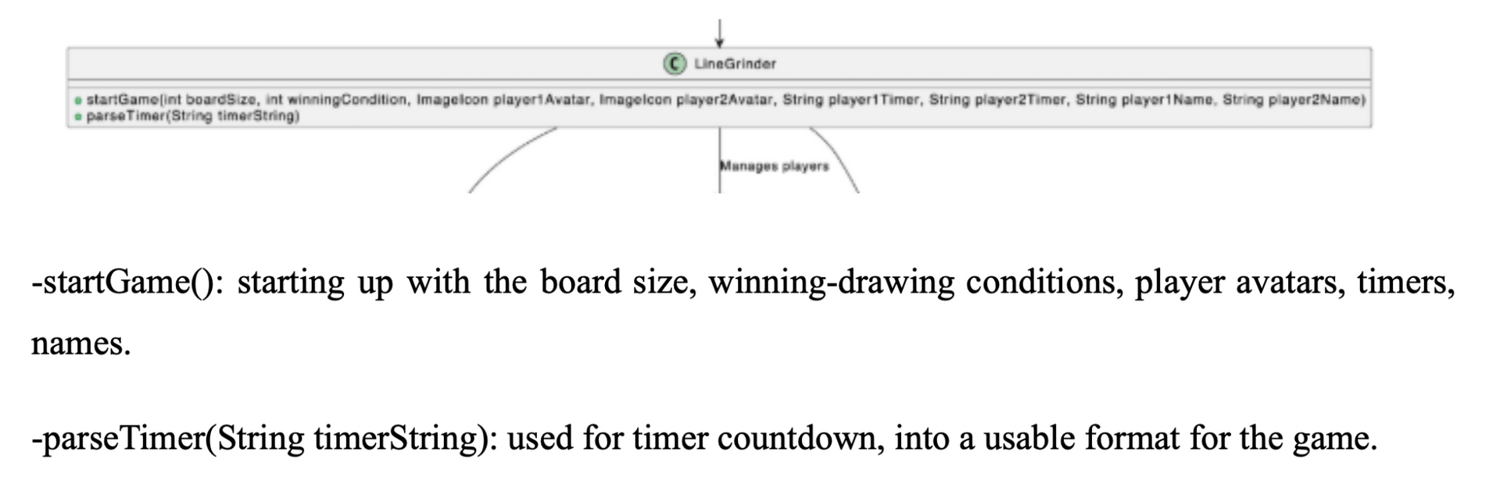
LineGrinder.java
-startGame(): starting up with the board size, winning-drawing conditions, player avatars, timers, names.
-parseTimer(String timerString): used for timer countdown, into a usable format for the game.

Slide 20
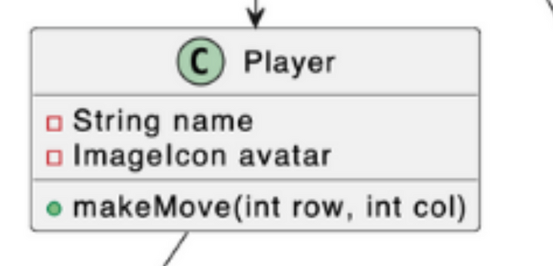
Player.java
-String name: Store player’s name.
-Imageicon avatar: Store the player’s chosen avatar.
-makeMove(int row, int col): Handles the player’s move by marking the chosen spot on the game board based on the row/columns of the board.

Slide 21
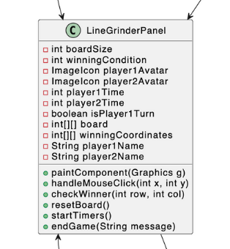
LineGrinderPanel.java
-paintComponent: Draws the game board and highlights the winning line when a player wins.
-handleMouseClick: Processes player clicks and updates the board, checks for a winner or tie, and switches turns.
-checkWinner: Checks if the latest move results in a win (5 in a row).
-resetBoard: Clears the board and restarts the game.
-startTimers: Runs timers for both players; the game ends if a timer runs out.
-endGame: Ends the game, shows the result, and offers restart or exit options.

Slide 22
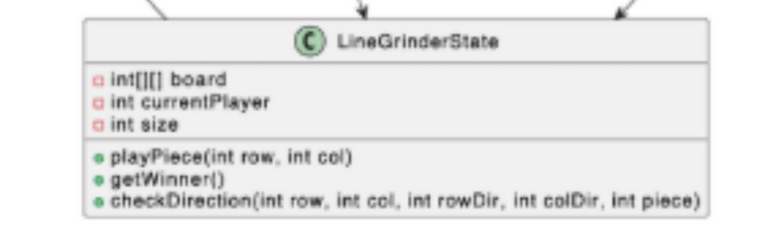
LineGrinderState.java: The Game Logic
-int[ ][ ] board: Represents the game board as a 2D array, where each cell stores the state (empty, X, or O).
-int currentPlayer: Keeps track of the player currently making a move (X or O).
-int size: The size of the game board (e.g., 3x3, 5x5).
-playPiece(int row, int col): Places the current player’s piece on the board and switches to the other player if the cell is empty.
-getWinner():
Checks the entire board to determine if there is a winner, a draw, or if the game is still ongoing.
Returns:
X (1) if Player X wins.
O (2) if Player O wins.
-1 for a draw.
NONE (0) if no winner yet.
-checkDirection(int row, int col, int rowDir, int colDir, int piece): Verifies if there are 5 consecutive pieces (horizontally, vertically, or diagonally) starting from the given cell in the specified direction.
-isBoardFull():
Checks if every cell on the board is filled, indicating a draw if no winner exists.
-getCurrentPlayer():
Returns the current player (X or O).

Slide 23
Git Explanation
Version Control
Collaboration via GitHub
Workflow
Benefits
Git was used to manage version control, ensuring all changes were tracked and merged smoothly.
The team used GitHub to store and share the project. Members cloned, edited, and pushed changes, enabling real-time collaboration.
Clone: Each member cloned the repository to start working.
Commit: Changes were committed with clear messages.
Push/Pull: Changes were pushed to the central repo and pulled to sync with others.
Collaboration: Enabled parallel development.
Tracking Changes: Git’s history allowed easy tracking and reverting of changes.
Conflict Resolution: Git tools helped resolve merge conflicts without losing work.

Slide 24

Lecture Applications
Object-Oriented Programming
Real-World Application
Design Patterns
Java and Swing
Encapsulation: Classes hide internal details, ensuring a clean interface.
Inheritance & Polymorphism: Used for reusability, such as different types of players (human, AI).
Abstraction: Complex game logic is abstracted for easier management and modularity.
Factory Pattern: Simplifies creation of players and game configurations.
Singleton Pattern: Ensures a single game state instance, managing consistency.
Java’s OOP features helped build modular, reusable game components.
Swing was used for creating an intuitive, interactive GUI.
Applied OOP principles and design patterns to create a scalable, maintainable, and engaging game.

Slide 25


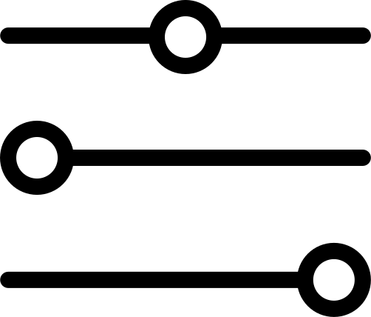


Limitation
AI: No challenging AI opponent, restricting single-player experience.
Online Multiplayer: Only local multiplayer is supported, excluding online play.
Customization: Customization is limited to board size, with no options for themes or player avatars.
Large Boards: Large board sizes can cause performance issues, particularly with win detection.
Graphics and Animations: Visuals and animations are minimal, which affects the immersive experience.

Slide 26

Online Multiplayer: Implement socket programming for online multiplayer to expand player reach.
AI Enhancement: Develop AI with adjustable difficulty levels for diverse player challenges.
Improved Customization: Add more customization options, such as themes, avatars, and sound effects.
Optimizing Performance: Enhance algorithms for better performance, especially with larger boards.
Better Graphics With Animations: Improve visuals and animations for a more immersive gaming experience.

Slide 27

REFERENCES
https://github.com/gomoku/Gomoku-Java/blob/master/Gomoku.java
https://stackoverflow.com/questions/22087006/using-arrays-to-detect-a-win-in-a-gomoku-game
https://github.com/rchen8/connect-five

Slide 28

THANK YOU!
Q&A TIME <3

